Slide 1

Ordinary and Partial Differential
Equations and Coordinate Geometry
Presented by (Group-1)
Md. Maruf Sarker
ID: 221002063
Mohammad Jahidul Islam
ID: 221002504
Tanvir Ahammed
ID: 221002036
Abdur Rahman
ID: 221002189
Imran Ime
ID: 221002470
Presented to
Name: Sharmin Alam
Designation: Lecturer, Dept of CSE
Department: BSC in CSE

Slide 2
Table of Contents:
The population of a city increases at a rate proportional to the present number. It has an initial population of 50000 that increases by 15% in 10 years. What will be the population in 30 years?
The rate at which a supercomputer body cools is proportional to the difference between the temperature of the body and that of the surrounding air. If a body in the air at 25°C will cool from 100°C to 75°C in one minute, find its temperature at the end of three minutes.
Under certain conditions, cane sugar is converted into dextrose at a rate, which is proportional to the amount unconverted at any time. If out of 75 grams of sugar at t = 0, 8 grams are converted during the first 3 minutes, find the amount converted in 1.5 hours.

Slide 3
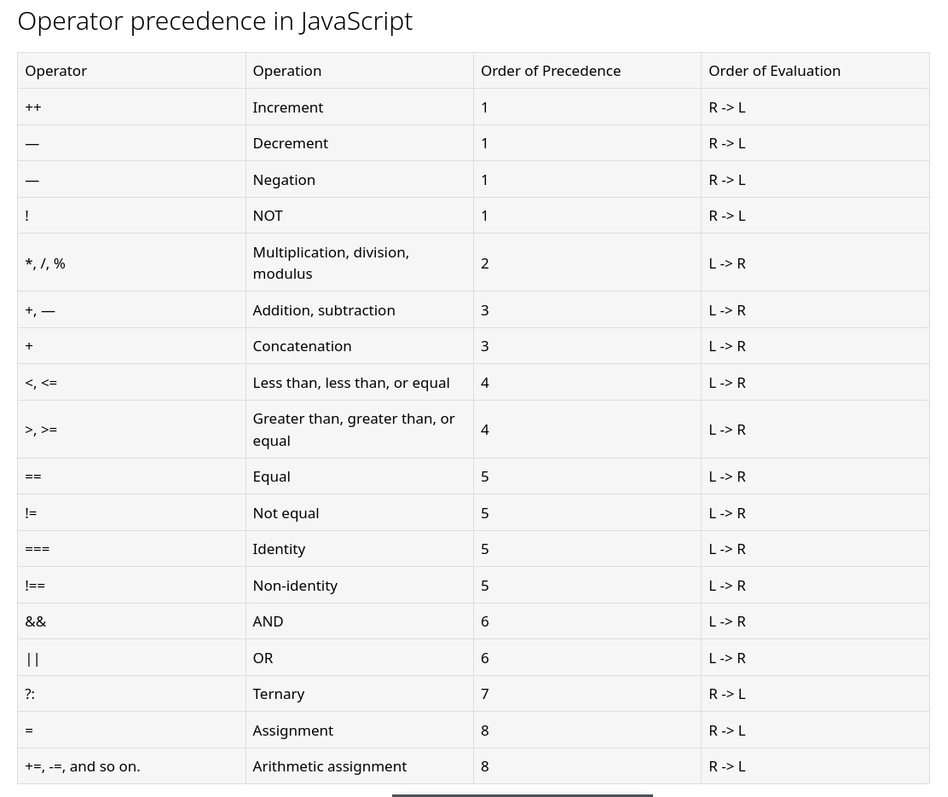
Operator Precedence

Slide 4
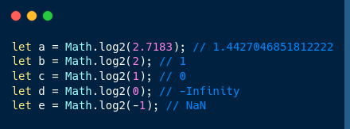
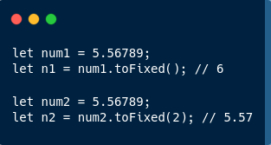
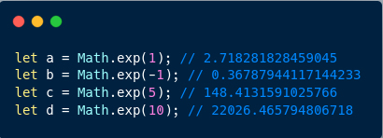
Calculate logarithm value
Calculate exponential value
Definition and Usage
The toFixed() method converts a number to a string.
The toFixed() method rounds the string to a specified number of decimals.

Slide 5
// The population of a city increases at a rate proportional to the present number. It has an initial population of 50000 that increases by 15% in 10 years. What will be the population in 30 years?
console.log(`Rate of growth is directly proportional to the present population number P(t) at time t,\n`)
console.log(`dp/dt = kp\n`)
let p0 = 50000, t, t10 = 10, t30 = 30;
console.log(`Given that,\n\t Initial population is ${p0}\n`)
let p10 = p0 + (p0 * 15 / 100);
console.log(`Population after 10 years = ${p10}\n`)
let k = -(Math.log(p0 / p10) / t10);
let p30 = p0 * Math.exp(k * t30);
console.log(`Population constant k = ${k.toFixed(3)}\n`)
console.log(`Population after 30 years = ${p30.toFixed(3)}\n`)

Slide 6
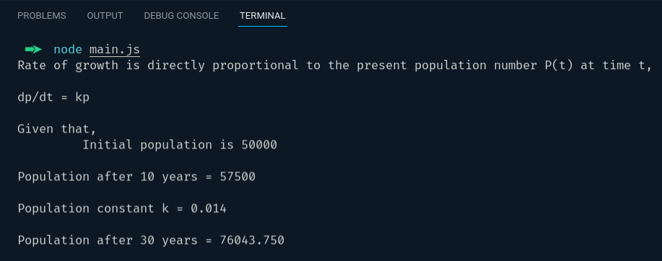
Output:

Slide 7
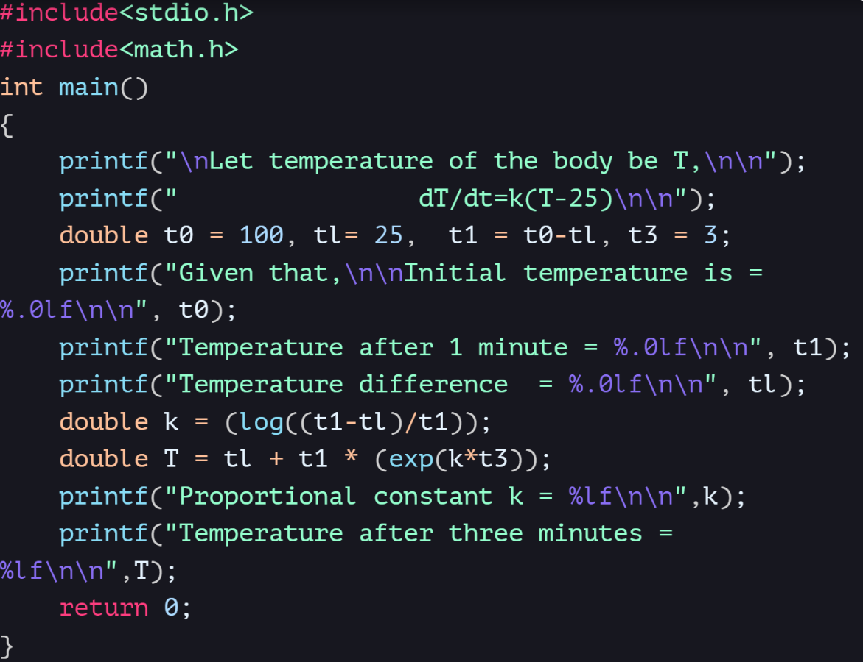
The rate at which a supercomputer body cools is proportional to the difference between the temperature of the body and that of the surrounding air. If a body in the air at 25°C will cool from 100°C to 75°C in one minute, find its temperature at the end of three minutes.

Slide 8
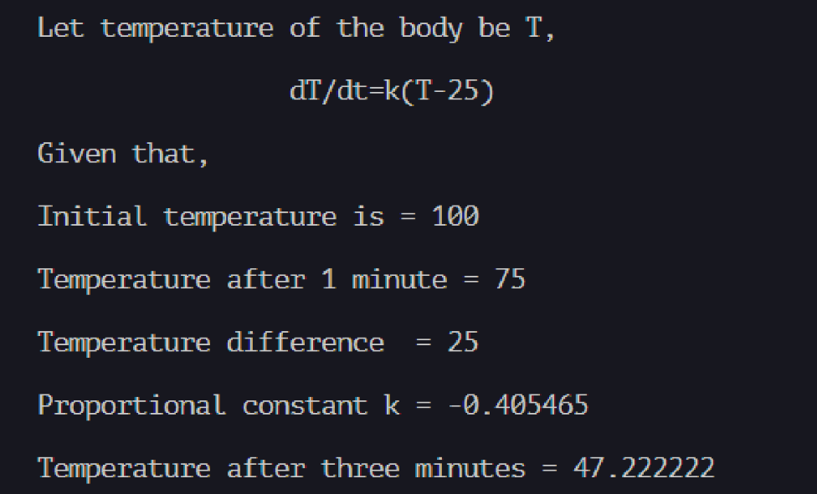
Output

Slide 9
1) sqrt(x)​
2) exp(x)​
3) log(x)​
4)log10(x)​
5) fabs(x)​
6) ceil(x)​
7)floor(x)​
8) sin(x)​
9)cos(x)​
10)tan(x)
Some important Function Under <math.h> :

Slide 10
Some Example:​
#include <stdio.h>​ #include <math.h>​ int main()​{​ printf("%f\n",sqrt(10.0));​ printf("%f\n",exp(4.0));​ printf("%f\n",log(4.0));​ printf("%f\n",log10(100.0));​ printf("%f\n",fabs(-5.2));​ printf("%f\n",ceil(4.5));​ printf("%f\n",floor(-4.5));​ printf("%f\n",pow(4.0,.5));​ printf("%f\n",fmod(4.5,2.0));​ printf("%f\n",sin(0.0));​ printf("%f\n",cos(0.0));​ printf("%f\n",tan(0.0));​ return 0;​
}​

Slide 11
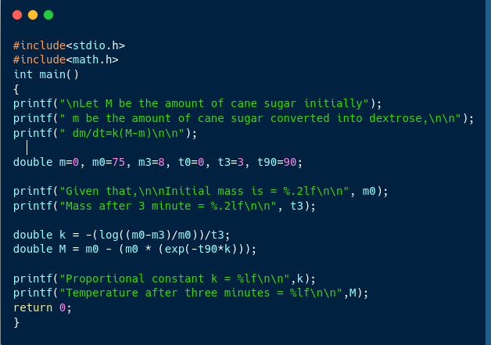
Under certain conditions, cane sugar is converted into dextrose at a rate, which is proportional to the amount unconverted at any time. If out of 75 grams of sugar at t = 0, 8 grams are converted during the first 3 minutes, find the amount converted in 1.5 hours.

Slide 12
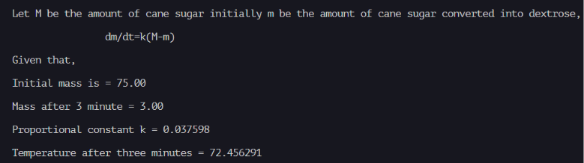
Output:

Slide 13
BENEFITS
Coding helps us to visualize abstract concepts.
We can explore the real-world applications of math concepts.
Math can be used in creative coding projects.
It can help us real life problem-solving skills in future.
It can make math more fun.

Slide 14
CONCLUSION
Mathematics teaches the usage of algorithms, which helps to develop logical thinking. Analytical thinking,which is the way of breaking down problems from unknown to known, can be quickly achieved through mathematics. We can implement any kind of math by coding… It is likely that math and coding are deeply related to each other.

Slide 15


